Slide 1

Remarkable Research & Trends in Biomedical Engineering
By. Pulasthi Ekanayake

Slide 2
Disclaimer
All images, trademarks, service marks and logos referred to or appearing on this presentation are the property of their respective owners.

Slide 3
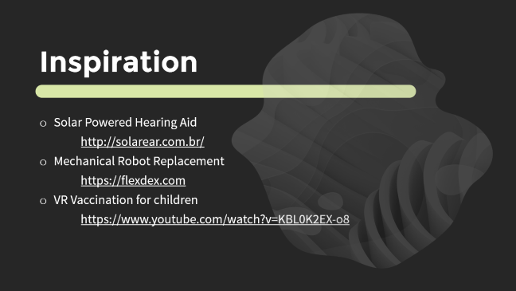
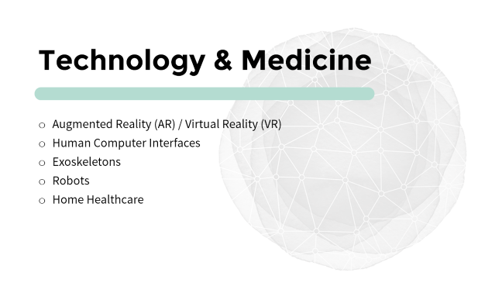
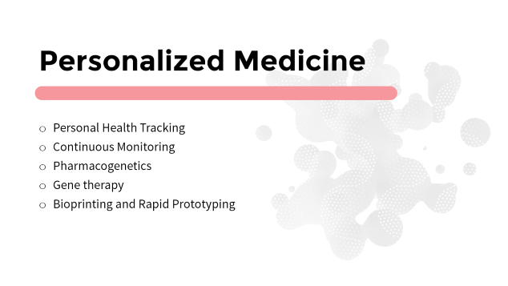
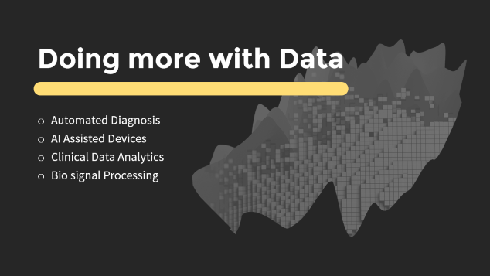

Slide 4
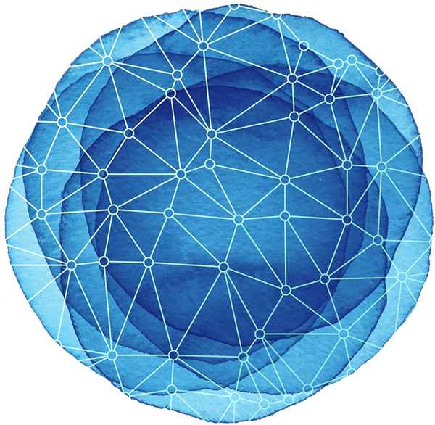
Technology & Medicine
Augmented Reality (AR) / Virtual Reality (VR)
Human Computer Interfaces
Exoskeletons
Robots
Home Healthcare

Slide 5
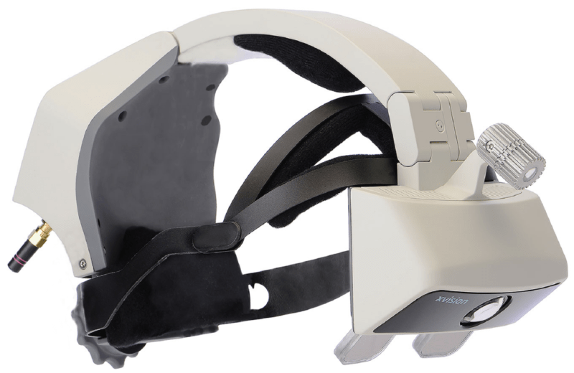
AR / VR
Augmented vision
Xvision
Therapy
Karuna Labs
Education
FundamentalVR
Microsoft Hololens

Slide 6
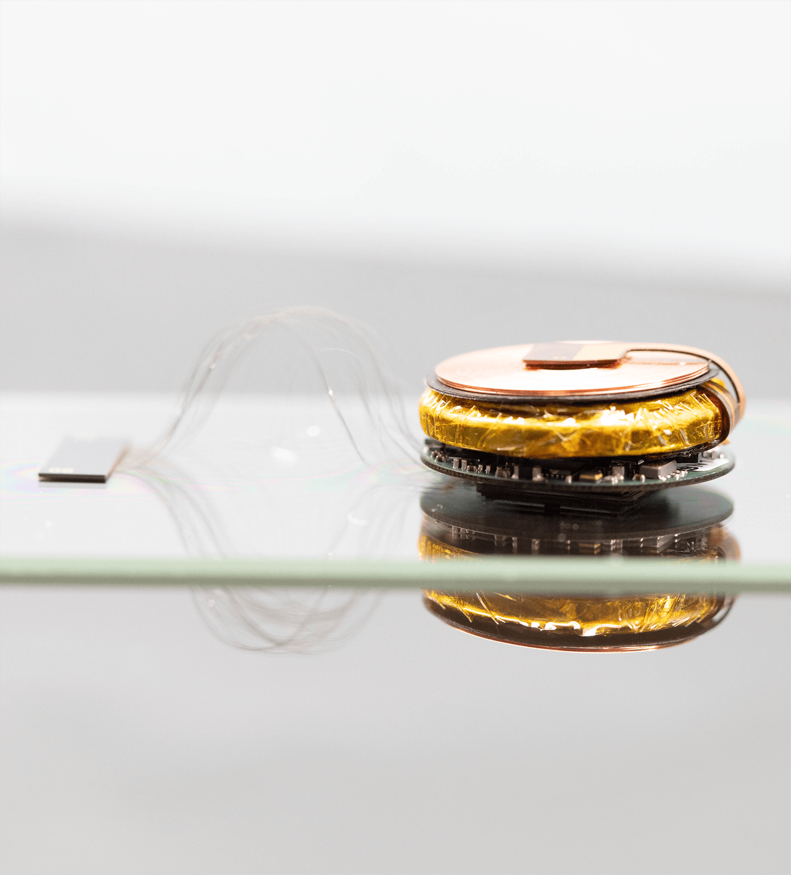
Human Computer Interfaces
Connected Humans
Neuralink
Overcoming disability
BME Dep. at University of Moratuwa

Slide 7
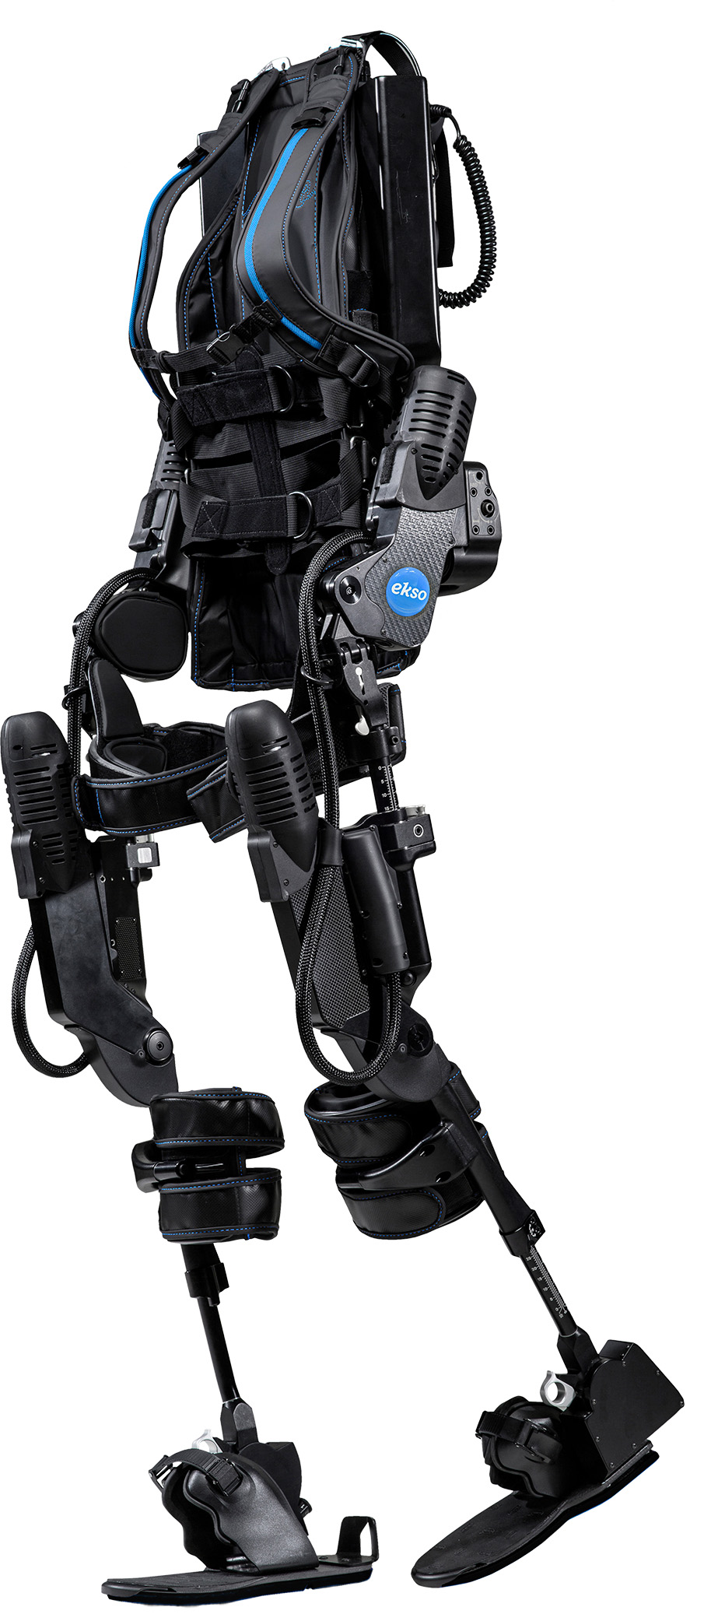
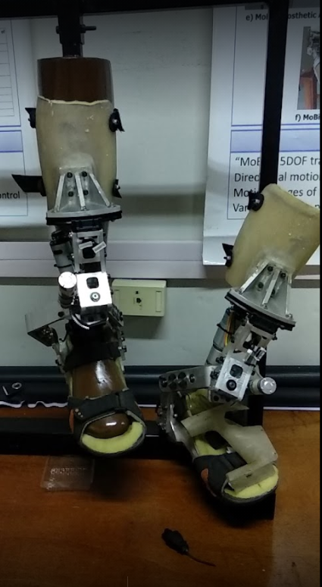
Exoskeletons
Augmenting Human Strength
SuitX
Esko Bionics
Prosthetics
ReWalk
Bionics Lab at University of Moratuwa

Slide 8
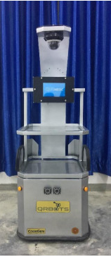
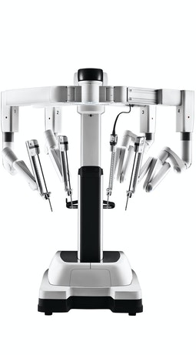
Robots
Robotic Assisted Surgeries
DaVinci Systems
Disinfection Robots
QRBots by CodeGen and the University of Peradeniya

Slide 9
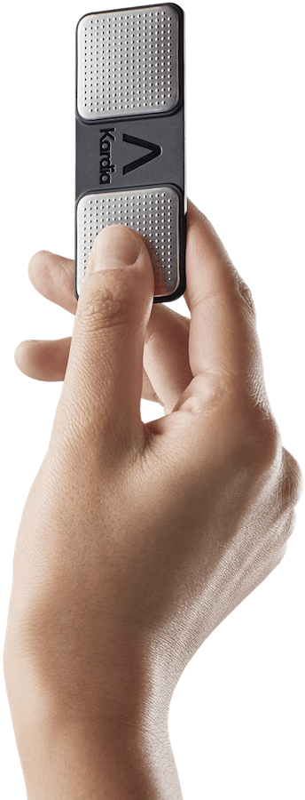
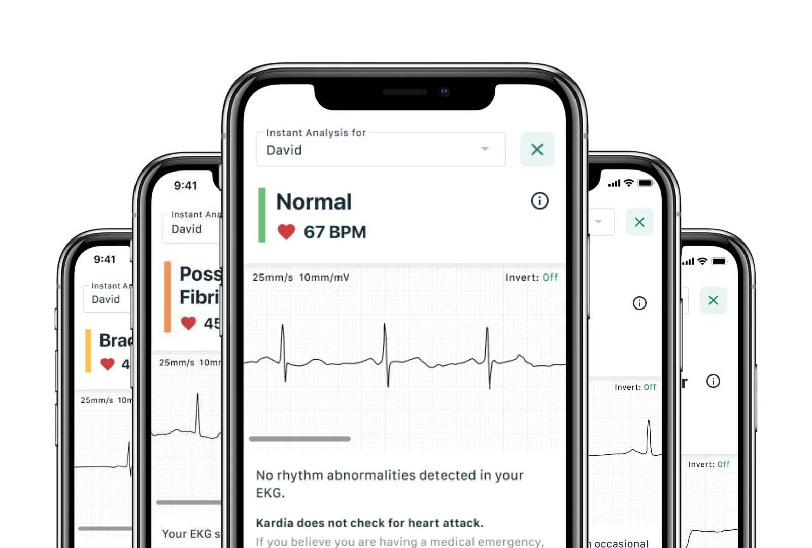
Home Healthcare
Ultrasound
Clarius
ECG
AliveCor

Slide 10

Doing more with Data
Automated Diagnosis
AI Assisted Devices
Clinical Data Analytics
Bio signal Processing

Slide 11
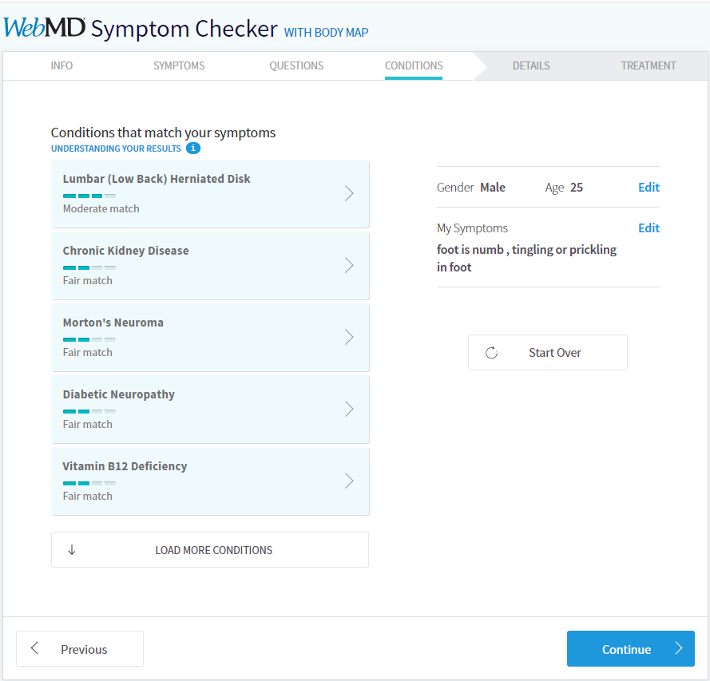
Automated Diagnosis
WebMD

Slide 12
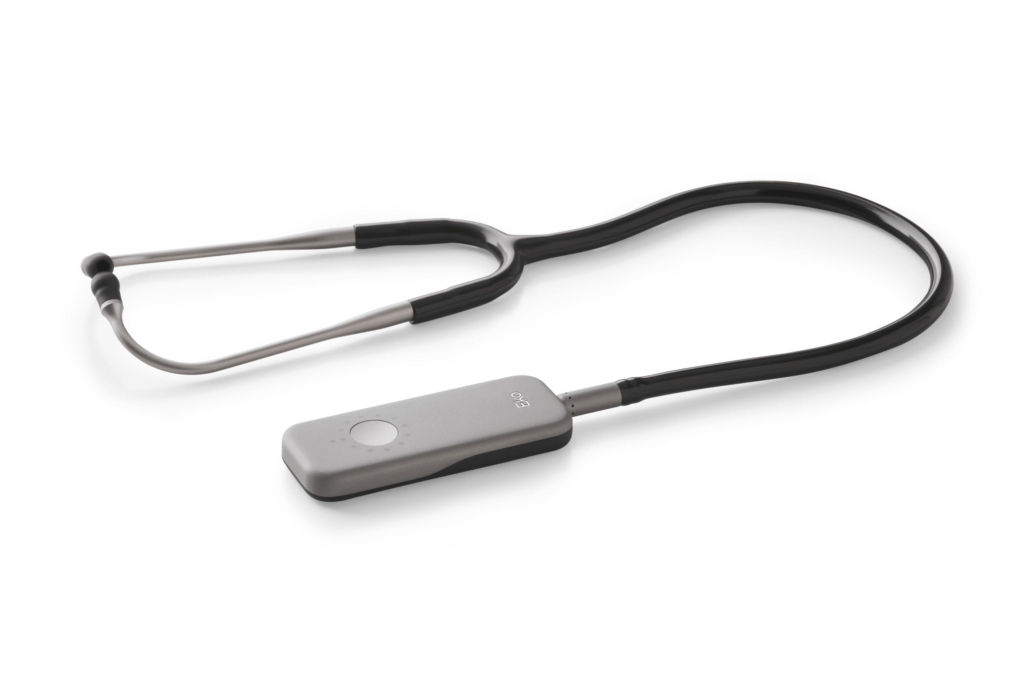
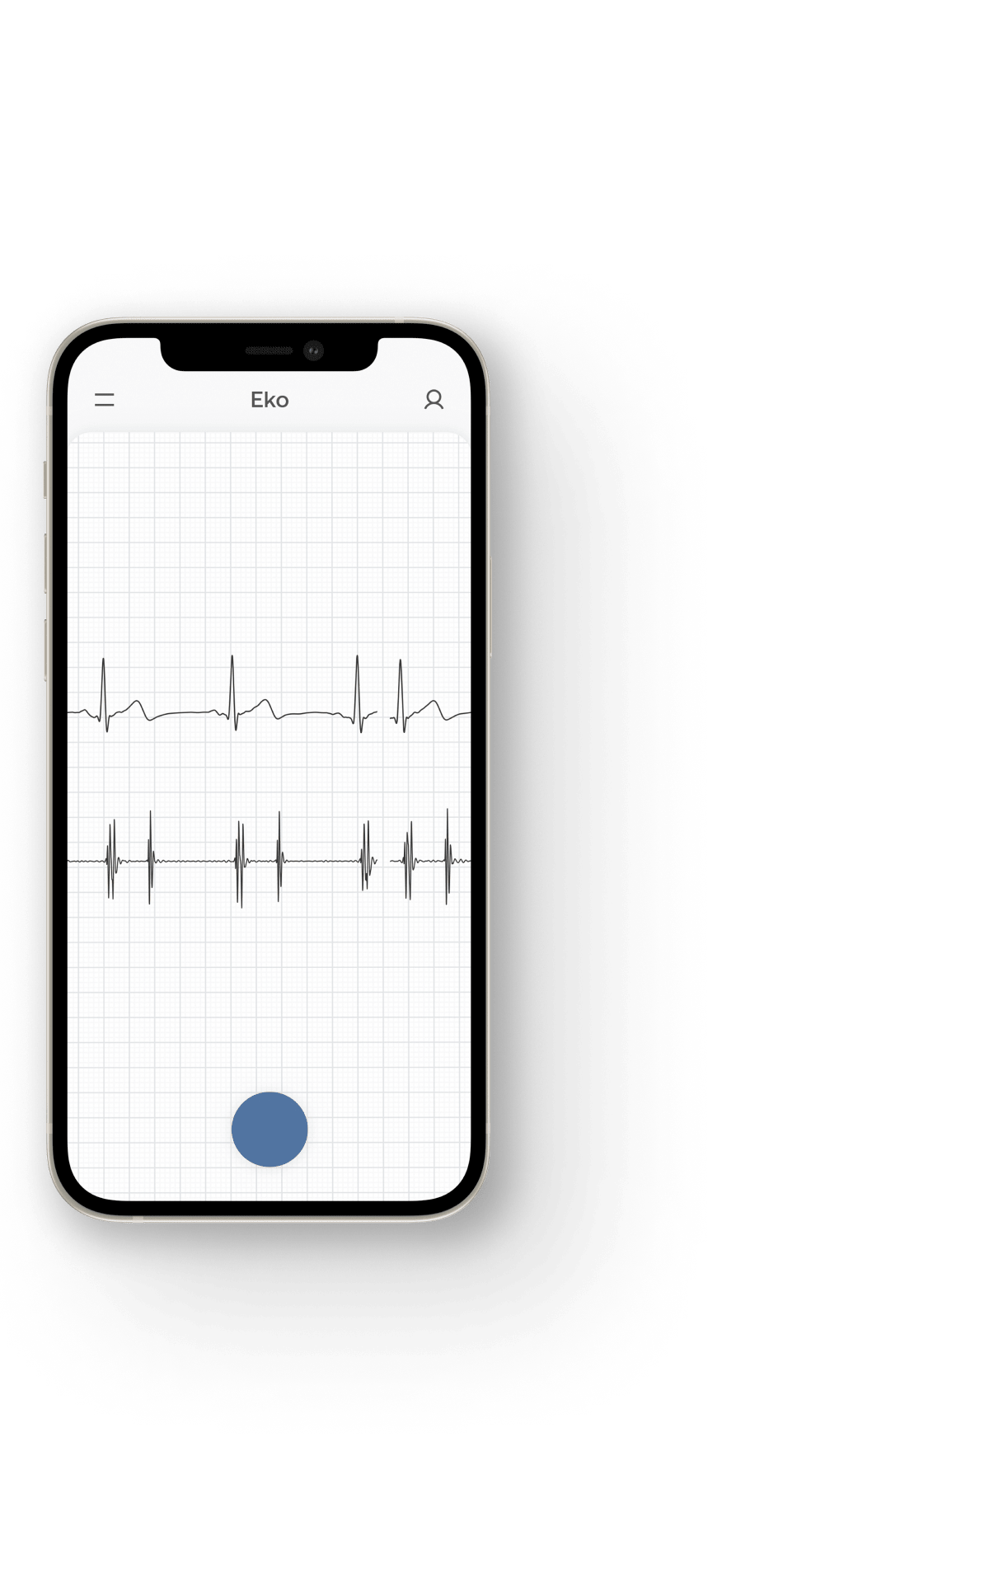
AI Assisted Devices
AI Stethoscopes
Eko
Intelliscope by BRIC
Surgery Robots

Slide 13
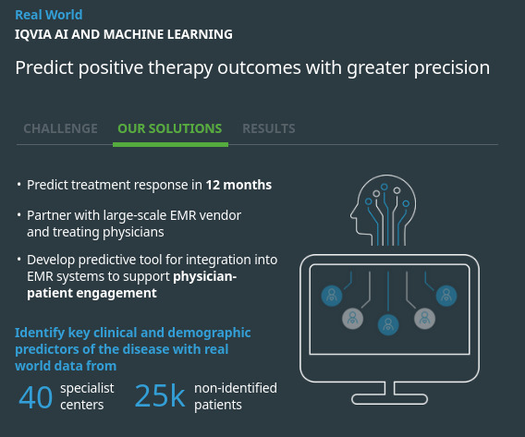
Clinical Data Analytics
Insights/ Trial Runs
IQVIA
Patient History
C|Glance

Slide 14
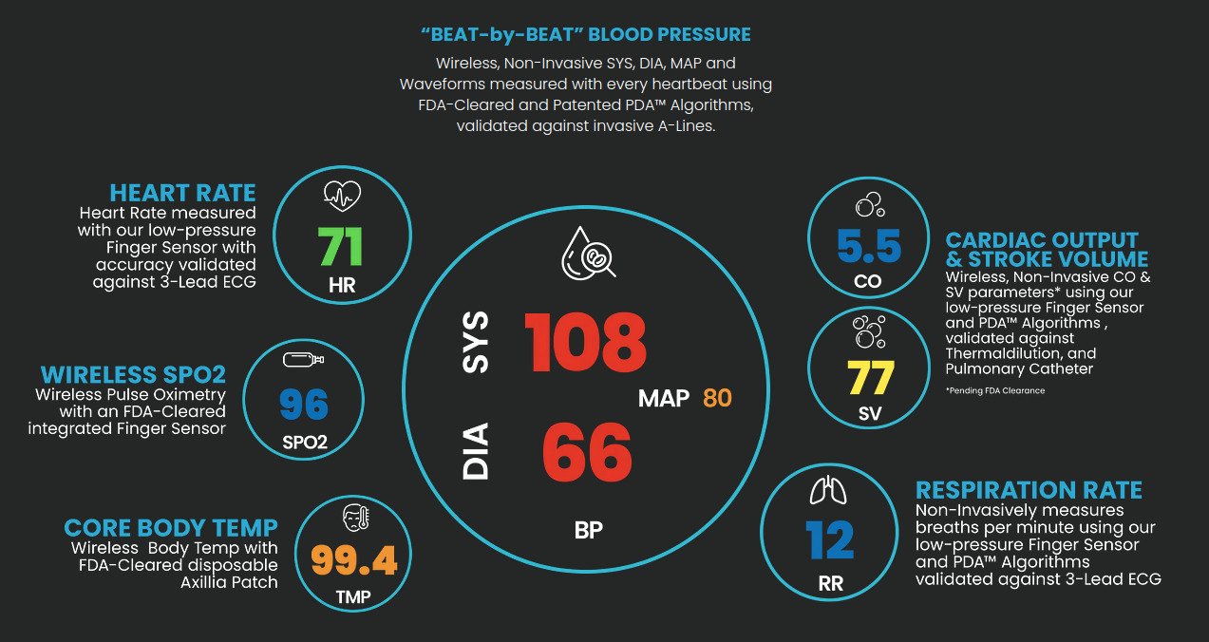
Biosignal Processing
Pulse Decomposition analysis
Caretaker Medical

Slide 15

Personalized Medicine
Personal Health Tracking
Continuous Monitoring
Pharmacogenetics
Gene therapy
Bioprinting and Rapid Prototyping

Slide 16
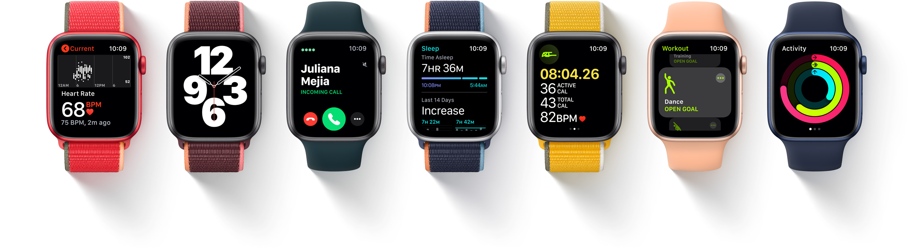
Personal Health Tracking
Fitness Monitoring
Apple
Samsung
Heart Rate, ECG, SPO2
Sleep Tracking
Body Composition

Slide 17
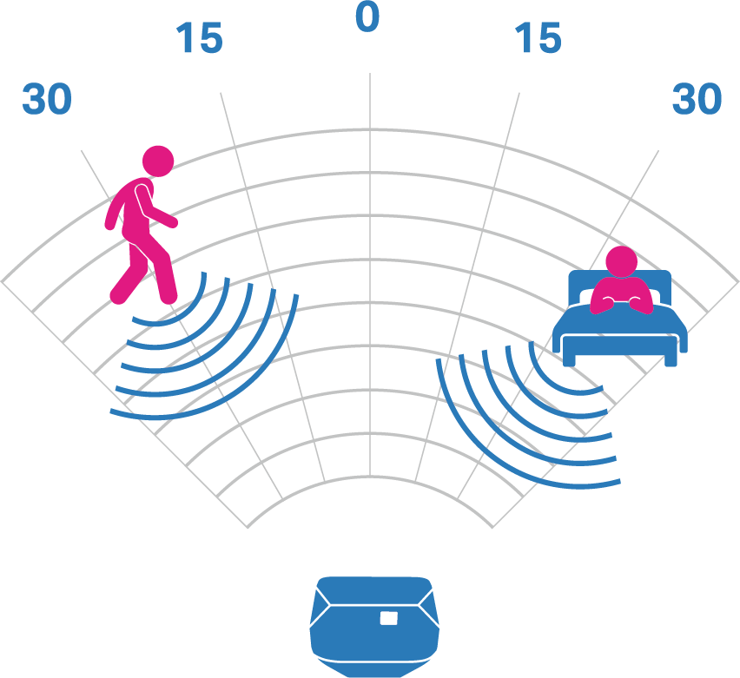

Continuous Monitoring
Wearable Monitors
Philips
Privacy focused
Raytelligence

Slide 18
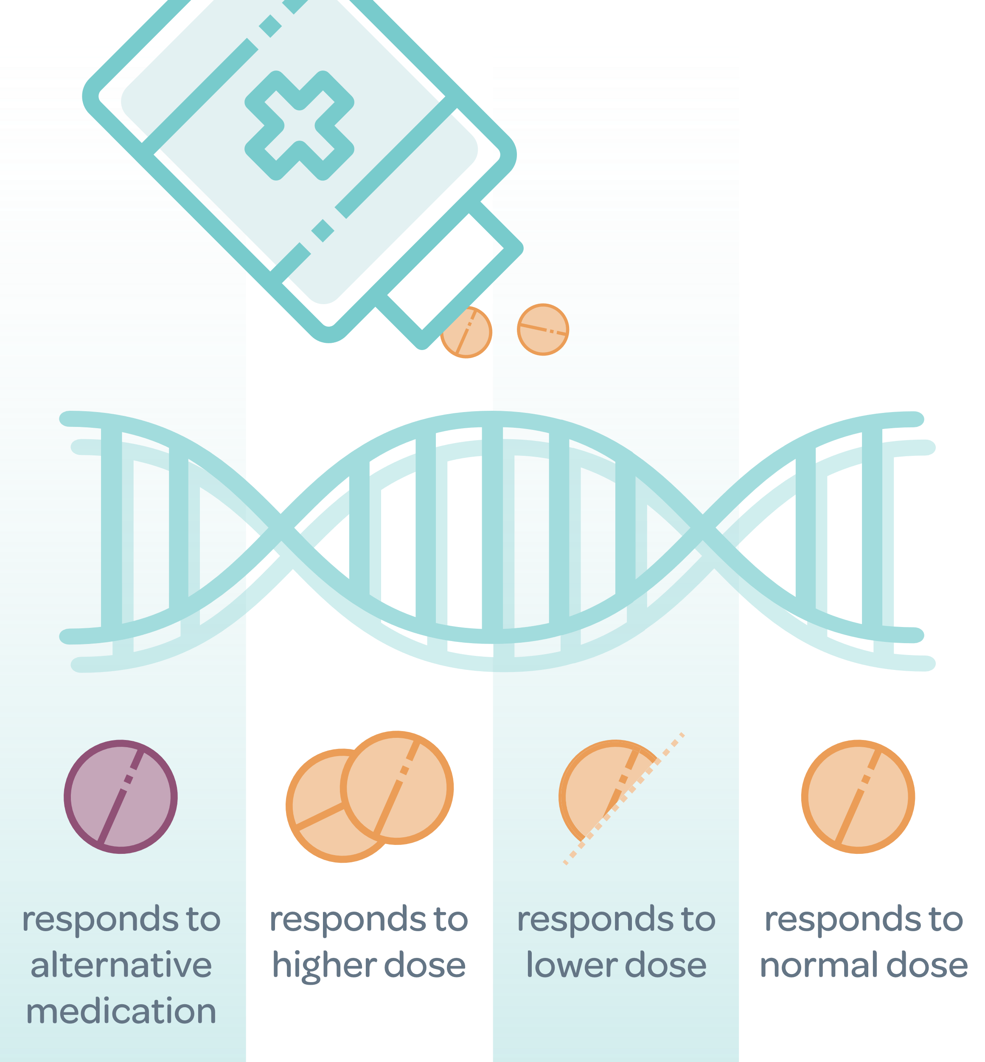
Pharmacogenetics
Why do some people have severe side effects to medicines, and why do medicine work better for some.
Genelex
Prevail

Slide 19
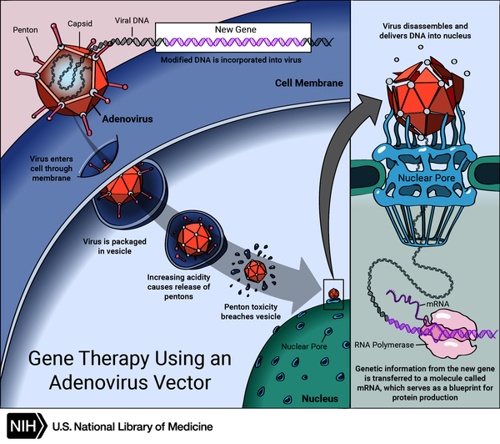
Gene Therapy
Gene Therapy
Introducing new genes that express functional proteins and thereby addressing the disease at the genetic level
Immunotherapy
T cell therapies that seek to help the body’s own immune system attack and destroy cancer cells

Slide 20
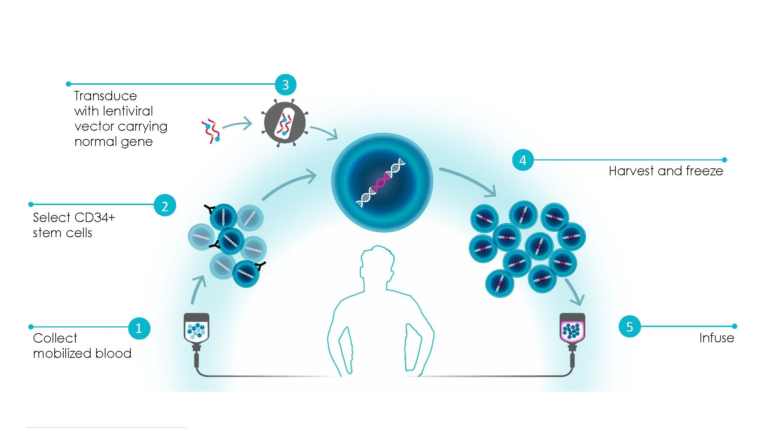

Slide 21
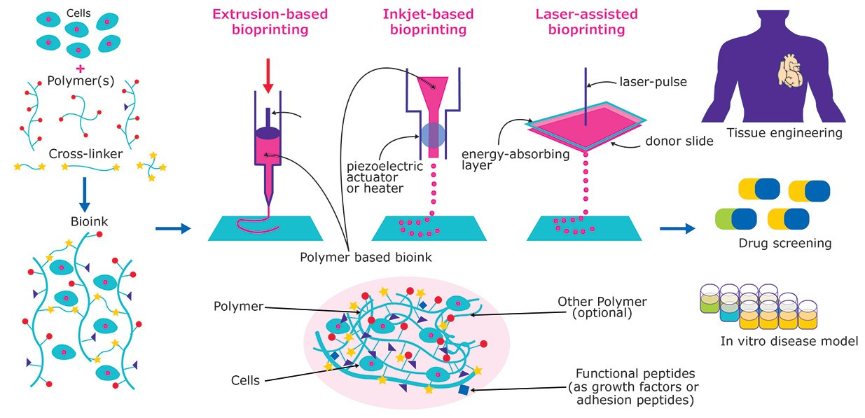
Bioprinting
CellLink Biolife4D

Slide 22

Inspiration
Solar Powered Hearing Aid
http://solarear.com.br/
Mechanical Robot Replacement
https://flexdex.com
VR Vaccination for children
https://www.youtube.com/watch?v=KBL0K2EX-o8

Slide 23

Thank You

